Slide 1
Recurrent Neural Networks

Slide 2

Content
1-Definition
2-Applications
3- Illustrated How RNNs works?
4-Types of RNNs
5-Disadvantages of RNNs
6-LSTM

Slide 3
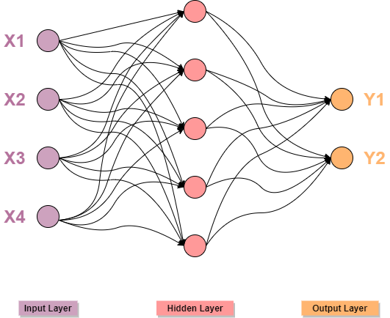
Definition of RNN
A recurrent neural network (RNN):
is a special type of artificial neural network adapted to work for time series data or data that involves sequences.

Slide 4
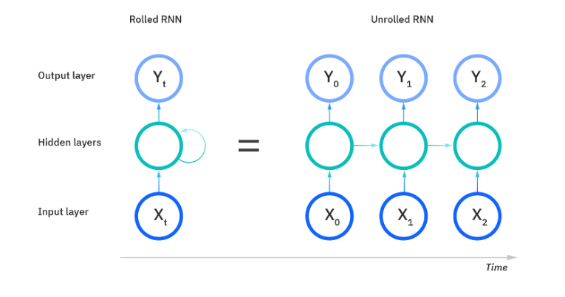
Illustrated How RNNs works?

Slide 5
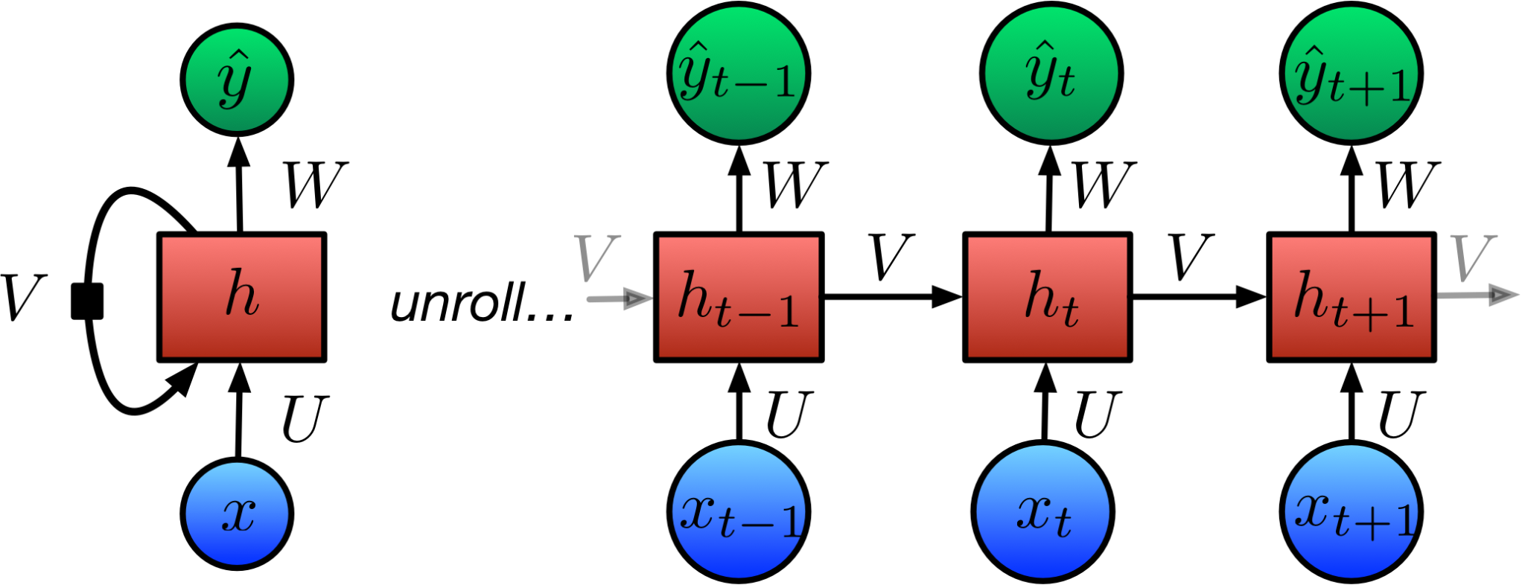
Illustrated How RNNs works?

Slide 6
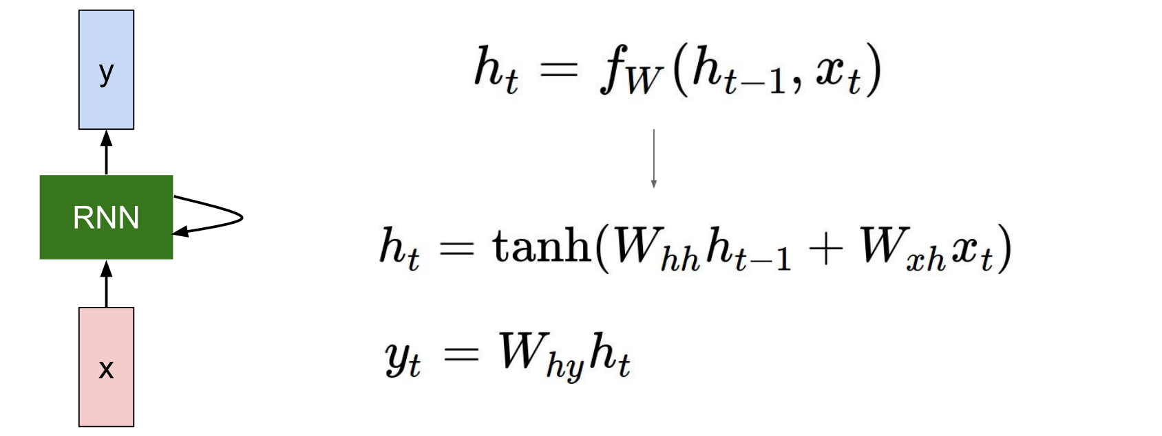
Illustrated How RNNs works?

Slide 7
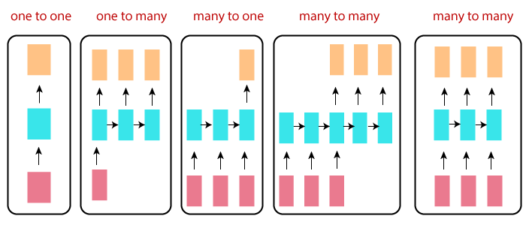
Types of RNNs

Slide 8
Applications
Natural Language Processing (NLP):
Language Modeling
Machine Translation
Sentiment Analysis
Speech Recognition and Synthesis:
Speech-to-Text
Text-to-Speech
Time-Series Analysis and Forecasting:
Financial Forecasting
Weather Prediction
Language Generation and Dialogue Systems: Chatbots
Music Generation:
Video Analysis and Action Recognition: Video Understanding & Gesture Recognition:

Slide 9
Disadvantages of RNN

Slide 10
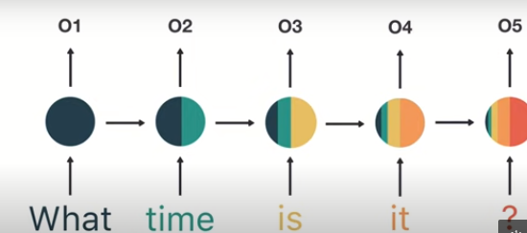
Disadvantages of RNN

Slide 11
Disadvantages of RNN
Training RNNs
RNNs cannot be stacked up
Slow and Complex training procedures
Difficult to process longer sequences
The vanishing or exploding gradient problem

Slide 12
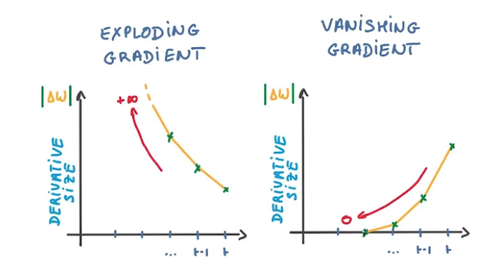
The vanishing and exploding gradient problem
source

Slide 13
Solve short-term memory problem
Gated Recurrent Units (GRU)
Long Short Term Memory (LSTM)

Slide 14
LSTM
designed to address the vanishing gradient problem in RNNs. LSTMs use three gates called input, output, and forget gate. these gates determine which information to retain.

Slide 15
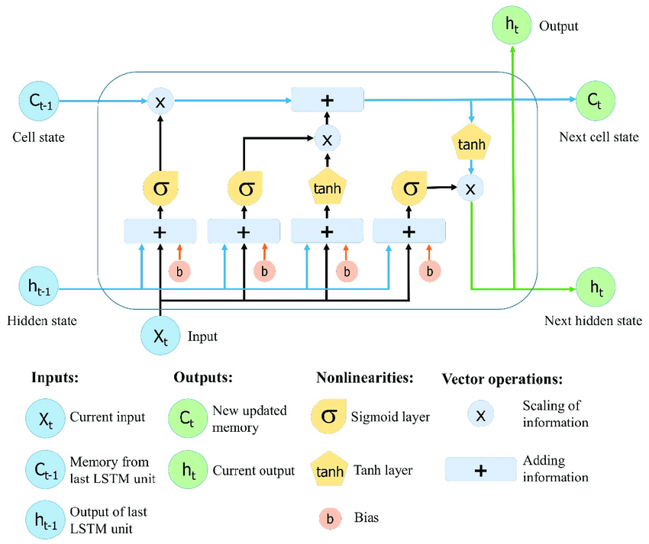
Architucture of LSTM

Slide 16

Any question

